Slide 1

Facial Emotion Detection
Submitted in the partial fulfillment for the award of the degree of
BACHELOR OF ENGINEERING
IN
Artificial Intelligence and Machine Learning
Submitted by:
Akshat Pareta
(20BCS6567)
Under the Supervision of:
Dr. Vijay Bhardwaj
Department of AIT-CSE
DISCOVER . LEARN . EMPOWER

Slide 2
Outline
S. No | Title | Slide number
1 | Introduction to Project | 3 - 5
2 | Problem Formulation | 6
3 | Objectives | 7
4 | System flow diagram | 8
5 | Methodology | 9 - 11
6 | Results and Output | 12 - 18
7 | Conclusion | 19
8 | Future Scope | 20
9 | References | 21 - 22

Slide 3
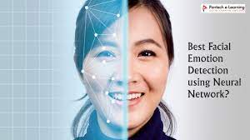
INTRODUCTION TO PROJECT
This model used Deep learning for image processing and TensorFlow for neural network training in the system.
A human face has significant and distinguishing characteristics that aid in the recognition of facial expressions.
The aim of this model is to explore the work of classifying the facial expression of a human face.

Slide 4
Purpose and Working of Facial Emotion Detection
By learning from character image data, the proposed method generates statistical character structure models built of probability distributions of strokes.
The most critical component in getting excellent recognition performance in character recognition systems is choosing a feature extraction strategy.
This application can be used to Recognition of change in facial expressions caused by individual’s internal emotional state

Slide 5
Dataset used and model accuracy
We will use the dataset which contain several image of different emotions like : Angry , Disgusted , Fearful, Happy, Neutral, Sad, Surprised.
The output for this model will also display the emotion of a person in a real time.
The accuracy of the prediction of this model is about 63% and this can be further improved by using larger datasets.
The major advantage of this model is that the user controls the entire process through a graphical user interface (GUI).

Slide 6
PROBLEM FORMULATION
Human facial expressions can be easily classified into 7 basic emotions: happy, sad, surprise, fear, anger, disgust, and neutral.
Our facial emotions are expressed through activation of specific sets of facial muscles. These sometimes subtle, yet complex, signals in an expression often contain an abundant amount of information about our state of mind.
Through facial emotion recognition, we are able to measure the effects that content and services have on the audience/users through an easy and low-cost procedure.
From detecting probable suicides and stopping them to playing mood-based music there is a wide variety of applications where emotion detection or mood detection can play a vital role in AI applications.
We designed a deep learning neural network that gives machines the ability to make inferences about our emotional states. In other words, we give them eyes to see what we can see.

Slide 7
Objectives
The proposed work is aimed to carry out work leading to the development of an approach for Detecting Facial Emotion. The facial emotion detection system, which is the proposed work will be achieved by dividing the work into the following objectives:
Obtain the facial emotion dataset from the web and detect the accuracy related to the emotions of the user and also eventually improve the Deep learning Models.
Work on different Deep learning Algorithms
Try to develop algorithms based on different models to achieve maximum accuracy.
To develop the GUI using flask and deploy the model on AWS.

Slide 8
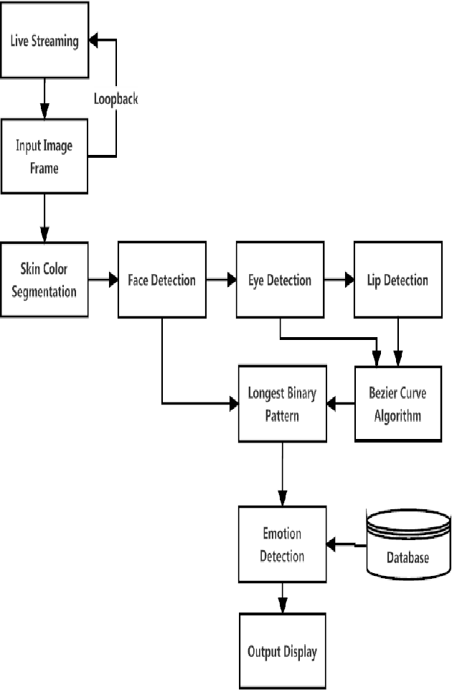
System Flow Diagram

Slide 9
Methodology
The following methodology will be followed to achieve the objectives defined for the proposed research work:
Training the public face database with CNN.
Extraction of seven probabilities for each frame of the face.
Aggregation of single-frame probabilities into fixed-length image descriptors for each image in the dataset.
Classification of all images using a support vector machine (SVM) trained on image descriptors of the competition training set

Slide 10
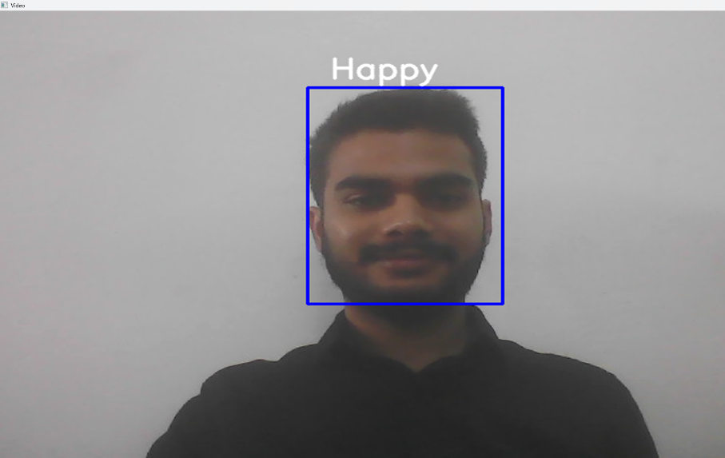
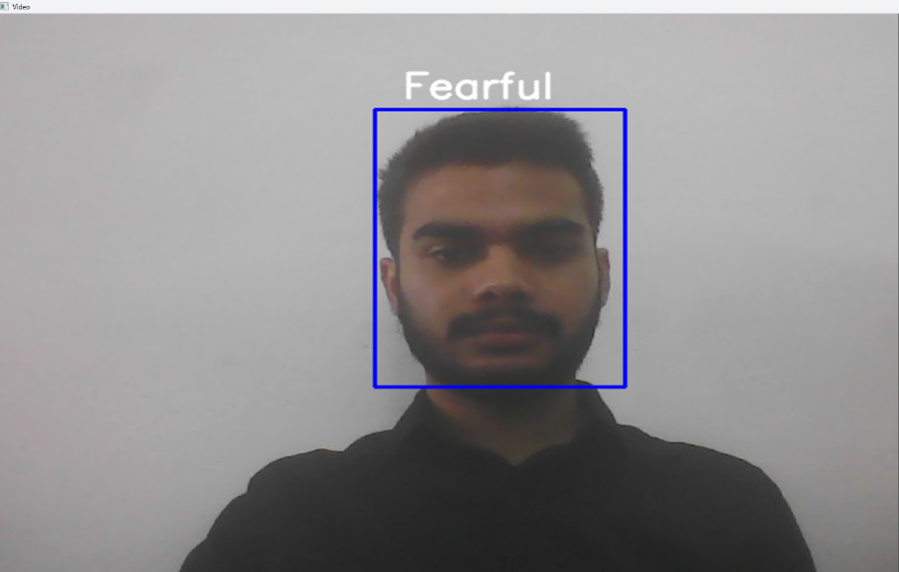
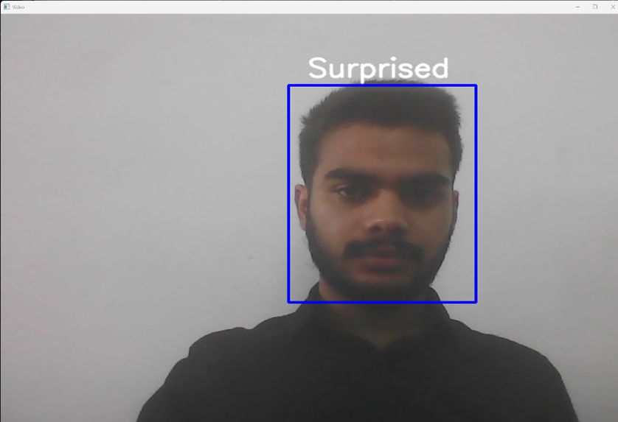
Detecting Facial Emotions In Real Time

Slide 11

Results and Outputs

Slide 12
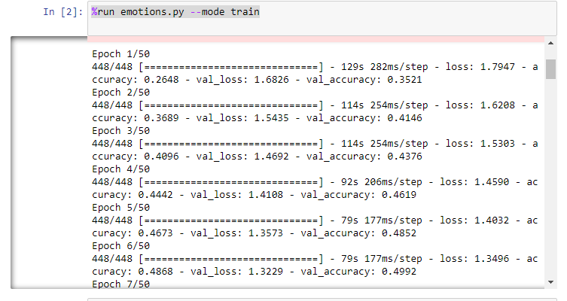

Slide 13
Conclusion
This project work described mostly focuses on the working and implementation of my machine learning model.
We intend to perform more changes to my current working model and make it a lot more efficient and portable with less character error rate and more accuracy in prediction.
We have shown the methodology used to create and execute this model with clear objectives and goals.
The main purpose of this model is to achieve the final output with the least amount of error rate in the recognition of handwritten script and print the final output as digital text.

Slide 14
Future Scope
If we want to improve your recognition accuracy, Increase the size of the dataset by applying more (random) transformations to the input images.
I intend to expand this research to a larger scale in the future so that different embedding models can be considered on a wider range of datasets.
This system will be used to detect more types of facial emotions .
To create an android application based on this Deep learning model.
Develop a fully working website for Facial Emotion Detection.
To improve prediction accuracy and get accurate results for the complex emotions.
To reduce the character error rate by training the model with more datasets and samples.
To integrate this model to an offline based system so that it runs completely without an internet connection.

Slide 15
References
P. S Aleksic and A. K. Katsaggelos, “Automatic facial expression recognition using facial animation parameters and multistream hmms,” IEEE Transactions on Information Forensics and Security, vol. 1, no. 1, pp. 3–11, 2006.
View at: Publisher Site | Google Scholar
H. Chouhayebi, J. Riffi, M. A. Mahraz, Y. Ali, and T. Hamid, “Facial expression recognition using machine learning,” in Proceedings of the 2021 Fifth International Conference On Intelligent Computing in Data Sciences (ICDS), pp. 1–6, IEEE, Seoul, Korea, November 2021.
View at: Publisher Site | Google Scholar
Anil. Audumbar Pise, H. Vadapalli, and I. Sanders, “Relational reasoning using neural networks: a survey,” International Journal of Uncertainty, Fuzziness and Knowledge-Based Systems, vol. 29, pp. 237–258, 2021.
View at: Google Scholar
J. Kim, M. Ricci, and T. Serre, “Not-So-CLEVR: learning same-different relations strains feedforward neural networks,” Interface focus, vol. 8, no. 4, 2018.
View at: Publisher Site | Google Scholar
E. Sariyanidi, H. Gunes, and A. Cavallaro, “Automatic analysis of facial affect: a survey of registration, representation, and recognition,” IEEE Transactions on Pattern Analysis and Machine Intelligence, vol. 37, no. 6, pp. 1113–1133, 2014.
View at: Google Scholar
6. Claude, C.C., Fabrice, B.: Facial Expression Recognition: A Brief Tutorial Overview (2002) Google Scholar
7. Liu, W.F., Wang, Z.F.: Facial Expression Recognition Based on Fusion of Multiple Gabor Features. In: 18th International Conference on Pattern Recognition (ICPR 2006), vol. 3, pp. 536–539 (2006) Google Scholar

Slide 16
8. He, L.H., Zou, C.R., Zhao, L., Hu, D.: An enhanced LBP feature based on facial expression recognition. In: 27th Annual Conference Proceedings of the IEEE Engineering in Medicine and Biology, Shanghai,China (2005) Google Scholar
9. Tan, H.-C., Zhang, Y.-J., Chen, H.: Person-independent expression recognition based on person-similarity weighted expression feature. Journal of Systems Engineering and Electronics, 118–126 (April 2010) Google Scholar
10. Aleksic, P.S., Katsaggelos, A.K.: Automatic facial expression recognition using facial animation parameters and multistream HMMs. J. IEEE Transactions on Information Forensics and Security 1(1), 3–11 (2006) CrossRef Google Scholar
11. Zhang, Z., Zhao, Z.: Expression Recognition based on Multi-Scale Block Local Gabor Binary Patterns with Dichotomy-Dependent Weights. In: Yu, W., He, H., Zhang, N. (eds.) ISNN 2009. LNCS, vol. 5552, pp. 895–903. Springer, Heidelberg (2009) CrossRef Google Scholar
12. Zheng, Z., Zheng, Z., Tiantian, Y.: Expression Recognition Based on 2 Dimensional MB-LGBP Features. Journal of Computer Applications (4), 964–966 (2010) Google Scholar
13. Lyons, M., Akamastu, S., Kamachi, M., Gyoba, J.: Coding Facial Expressions with Gabor Wavelets. In: IEEE Conf. on Automatic Face and Gesture Recognition, pp. 200–205 (1998) Google Scholar
14. Hsu, C.-W., Chang, C.-C., Lin, C.-J.: A practical guide to support vector classification, pp. 1–12. National Taiwan University (2004) Google Scholar

Slide 17


